Slide 1
Collaborative Filtering(CF) Based Recommendation System Collaborative filtering mostly divided into two sections : User based filtering and Item based filtering.
User based CF
An user based filtering takes a particular user and find the other similar used based on their similarity in purchase history or based on similarity of ratings and recommend items those are similar users liked/purchased.
Features
Dependency
Real time use case
This model takes a customer as an input and find other customers that are similar to this input user based on similarity ratings and recommend items those similar customers liked or purchased.
Customer’s demographic data
Recommendation of movies in Netflix based on other similar user watching other movies.

Slide 2


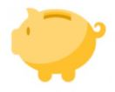
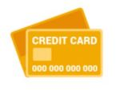
Collaborative Filtering(CF) Based Recommendation System
.
Customer based CF
The process is to calculate the similarities between the target customers and all other customers. The idea is to find the most similar customers to our target customer (nearest neighbors) and weight their transaction they are doing in a product as the prediction of the rating of this product for target customer.
Bought
Bought
Similar
Bought
Bought
Bought
Likely Buy

Slide 3
Collaborative Filtering(CF) Based Recommendation System Collaborative filtering mostly divided into two sections : User based filtering and Item based filtering.
Item based CF
Item filtering will take an item, find users who liked that item and find other items that those users or similar users also liked and recommend those other items. In this approach this model will take an item as an input and recommend other items as output.
Features
Dependency
Real time use case
For an item I, with a set of similar items determined based on rating vectors consisting of received user ratings, the rating by a user U, who hasn’t rated it, is found by picking out N items from the similarity list that have been rated by U and calculating the rating based on these N ratings.
1. Product ratings given by customers.
2. Transactions done to each products by individual customers
1. Netflix movie recommendation based on movie ratings.
2. Amazon product recommendation based on product rating.

Slide 4

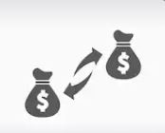
Collaborative Filtering(CF) Based Recommendation System
Item(Product) based CF
This item-item(product) based filtering was invented by Amazon and its widely used in many business now. Here we can execute similarity detection between the products based on their characteristics. Based on the similarity score we can recommend top scored product to the target customer.
Corporate Loan
Bought
Similar
Interest Rate Swap
Recommend

Slide 5
Deduplication check using Similarity Detection Customer data is currently scattered across multiple systems, There are too many systems maintaining data of same customer There is no universal customer ID and every system has a different identifier for the customer.
Features
Dependency
Real time use case
This model checks the customer information from various source of data and using similarity detection n algorithm on customer information it will identify the customer as similar
1. Set of attributes of customer KYC to identify a customer uniquely. e.g. Customer First name, Last name, Date of birth, email , SSN(Passport number) can uniquely identify a customer.
De duplication check in Direct banking system
New user registration in Netflix, Spotify etc.

Slide 6
Deduplication check using Similarity Detection
We represent customer information and relationships in a graph DB by bringing together a reference data from multiple systems with the help of similarity detection algorithm present in Neo4j
We have taken a sample customer data below where customer data is scattered in different LOB systems(GBM, CMB etc). Here We are (POC scope) that KYC Name(Customer’s official name as per KYC) is unique.
As per below data though customer Names are different and from different LOB but their KYC names are same so similarity detection algorithm is identifying that these are same customers but their data are scattered in different systems. Similarly CIND 1002 & 1007 have same Name but here KYC Names are different so Similarity algorithm will identify these as different customers.
CIND | Name | LOB | Product | KYC Name
1001 | Wendy's | GBM | PAD, PAY, Loans | Wendy's
1002 | Richard Johnson | GBM | PAY,Loans | Rick John
1003 | Sina Lamers | CMB | PAY | Sina Lamers
1004 | Jonathan Parker | CMB | PAD, Loans | Jonathan Parker
1005 | Steve Moore | GBM | ADD, PAY | Steven max
1006 | Wendy's | GBM | ADD, PAY | John
1007 | Richard Johnson | CMB | ADD, PAY, Forx, PreciousM | Richard Johnson
1008 | S Lamers | GBM | PAY, Loans, Forx | Sina Lamers
1009 | Jonathan P | GBM | Loans | Jonathan Parker
1010 | Steve Moore | CMB | PAY, Loans | Steve Moore
Different Customer
Same Customer
Same Customer

Slide 7
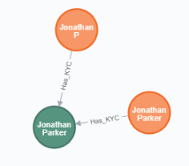
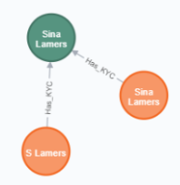
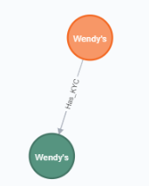
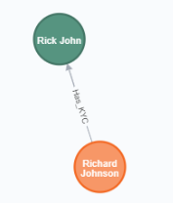
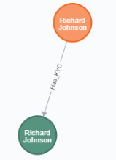
Deduplication check using Similarity Detection
After implementing similarity detection algorithm in Neo4j, We can see the below graphical representation of various customers.
Jonathan P & Jonathan Parker data are scattered in two different LOB system but similarity detection algorithm detected these are same customers.
There are two Richard Johnson but their KYC names are different so Similarity detection algorithm detected them as Unique customers though they are having same customer names.
Same customer | Unique customer

